Slide 1
Scope of Psychology of Happiness

Slide 2
“Positive psychology is a scientific approach to studying human thoughts, feelings, and behavior, with a focus on strengths instead of weaknesses, building the good in life instead of repairing the bad, and taking the lives of average people up to great instead of focusing solely on moving those who are struggling up to normal” (Peterson, 2008)

Slide 3
As a field, positive psychology focuses on topics like character strengths, optimism, life satisfaction, happiness, well-being, gratitude, compassion (as well as self-compassion), self-esteem and self-confidence, hope and elevation
These topics are studied to find out how people can live their best lives.

Slide 4
Some of the most impactful and influential outcomes of practicing positive psychology…
teaches us the power of shifting one’s perspective : a relatively small change in one’s perspective can lead to big shifts in well-being and quality of life
At workplace : Positive emotions boost job performance, experiencing positive emotions actually increases our chances of success (Lyubomirsky, King, & Diener, 2005)

Slide 5
Important : “forcing people who are not naturally optimists to “just think positively” can do more harm than good; unrealistic optimism is detrimental, along with intense pessimism” (del Valle & Mateos, 2008; Dillard, Midboe, & Klein, 2009

Slide 6
Coaching/ Counseling setting :
Increase the client’s experience of positive emotions
Help clients identify and develop their strengths and unique talents
Enhance the client’s goal-setting and goal-striving abilities
Build a sense of hope into the client’s perspective
Help the client build and maintain healthy, positive relationships with others

Slide 7
If you’re looking to enhance your own sense of authentic happiness and well-being, all you need to do is focus on….
Experiencing more positive emotions; do more of the things that make you happy
Working on increasing your engagement; pursue hobbies that interest you, develop your skills, and look for a job suited to your passions
Improve the quality (and/or quantity) of your relationships with others; work on building more positive and supportive relationships with your friends, family, and significant other(s);

Slide 8
Seek out meaning; if you don’t find it through your work, look for it in volunteering opportunities, personal hobbies or leisure activities, or acting as a mentor for others;
Keep your focus on achieving your goals—but don’t focus too hard; try to keep your ambition in balance with all of the other important things in life (Seligman, 2011).

Slide 9
Main areas where it will be helpful are-
Sports / / Competition
Business
In all human relations
Research & Analysis works
Education

Slide 10
Sports: Enhance performance.
Various mental strategies, such as visualization, self-talk and relaxation techniques, can help athletes overcome obstacles and achieve their full potential.
Helps to cope with the pressures of competition.

Slide 11
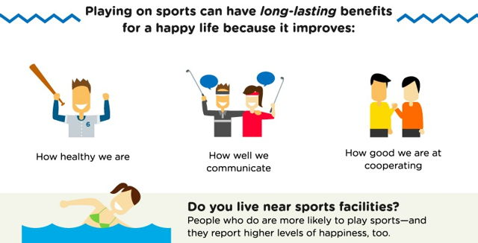

Slide 12

One great example is the story of Jason McElwain, a 2006 graduate of Greek Athena High School in Rochester, New York.
Notes:
https://video.search.yahoo.com/search/video;_ylt=Awr47KbvTB1exlQAswdXNyoA;_ylu=X3oDMTE0Y3FkOGJxBGNvbG8DZ3ExBHBvcwMxBHZ0aWQDQjkzMTdfMQRzZWMDcGl2cw--?p=jason+mcelwain+basketball&fr2=piv-web&fr=mcafee#id=9&vid=95e71aaf6841982c68bc8e24ea27d84c&action=view

Slide 13
Autism & Basketball: Jason McElwain
Five Years ago on February 15th, 2006 Jason McElwain was a little known teenager. At an early age Jason was diagnosed with autism. As he grew up his brother Josh introduced him to basketball and eventually he ended up as the manager of his high school basketball team, Greece Athena High School near Rochester, New York. As the team manager Jason did not expect to play but his coach Jim Johnson had other ideas.
Notes:
https://www.mayoclinic.org/diseases-conditions/autism-spectrum-disorder/symptoms-causes/syc-20352928

Slide 14

Process Improvement (Business): is the positive task of identifying, analyzing and improving upon existing business processes within an organization for optimization and to meet new quotas or standards of quality.

Slide 15
In all human relations
Positive Parenting : is for parents that want to discipline their kids without breaking their spirit.
  It is a program that is focused on developing a strong, deeply committed relationship between parent and child based on communication and mutual respect.

Slide 16
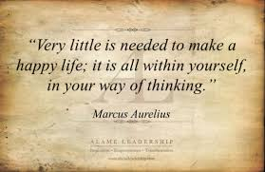
Positive Parenting focuses on teaching children not just what but also why. Positive parenting means training children toward self-control

Slide 17
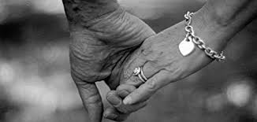
2. Healthy marriages:
Addresses the construction of a healthy marriage by examining the elements that, taken together, help to define it, such as commitment, marital satisfaction, and communication, as well as two elements that pose obvious threats to healthy marriage, violence and infidelity.
Notes:
Infidelity: being unfaithful

Slide 18
Strategies For A Happier Life.
Two positive psychologists in the west of England came together years ago to develop the Happiness Training Plan, an audio programme of practical strategies for a happier life, which was launched at the 2008 Happiness Lectures at the University of Bristol.
Drawing on positive psychology research and personal experience of overcoming depression, Chris and Miriam formulated 12 practical strategies for a happier life.

Slide 19
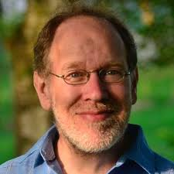
Dr. Chris Johnstone
A medical doctor who has prepared the use of positive psychology through his work as an addictions specialist.

Slide 20
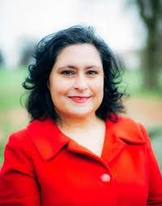
Miriam Akhtar
is a coach and consultant who discovered positive psychology when she produced one of the first programmes on the science of happiness for BBC Radio 4.

Slide 21

1 – Express Gratitude
Practice switching focus from the glass half empty to the glass half full by savouring the good things you have in your life.
Expressing gratitude, is a powerful way to develop happiness.

Slide 22
2 – Find Your Power
This strategy is about finding the motivation to move past obstacles and feeling empowered to achieve goals.
Using the cycle of dream, plan, do and review is a way to overcome stuckness and make positive change.

Slide 23
3 – Use Your Strengths
Identifying your natural talents and finding new ways of using your strengths is a route to long-lasting happiness.
4 – Live With Purpose
Finding a sense of purpose, a direction in life, brings together two of the three pillars of happiness – meaning and engagement. Identify your life purpose and take steps towards bringing it into reality.

Slide 24

5 – Get Physically
healthy
Physical activity stimulates the production of “happy hormones”.
The most popular ones are endorphins, dopamine andserotonin.
Research shows that physical activity can be more effective than anti-depressants in depression recovery.
Notes:
https://www.youtube.com/watch?v=skaakb6bmLU

Slide 25
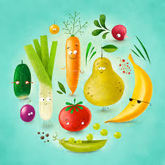

6 – The Happiness Diet
Food influences mood, in
particular through the impact
of blood sugar on emotional state.
To produce serotonin, the brain chemical associated with good mood, you need to eat foods containing the
amino acid tryptophan,
found in chicken, fish,
beans and brown rice.
Notes:
http://www.eatingwell.com/video/6936/foods-that-help-make-you-happy/
https://www.youtube.com/watch?v=tdrnbsS-oPk

Slide 26
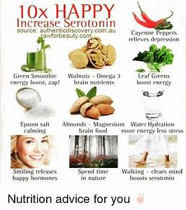

Slide 27
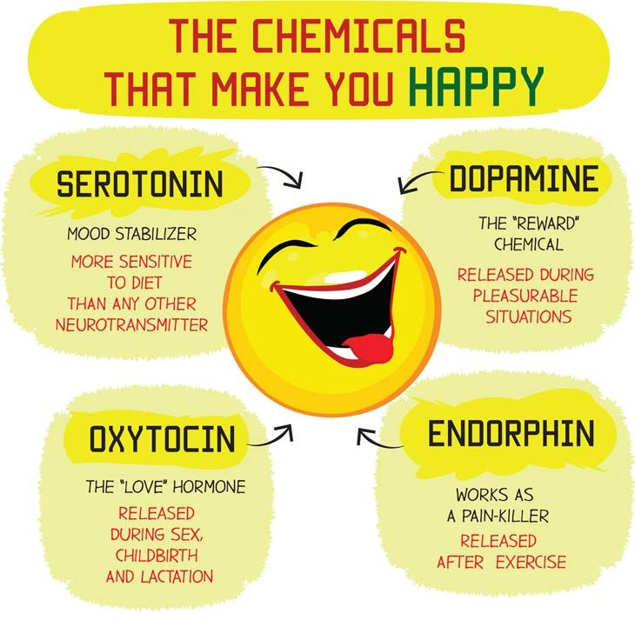

Slide 28
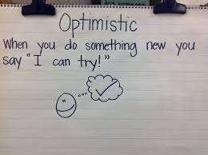
7 – Learning Optimism
One of the most
powerful ways to boost
happiness is by learning
the skills of optimism.
Notes:
https://www.pursuit-of-happiness.org/science-of-happiness/positive-thinking/

Slide 29
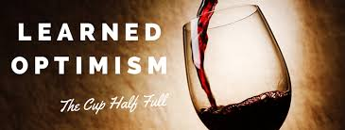
Pessimism is a fast track to depression but the good news is that it is possible to develop greater optimism through techniques like reframing and disputing pessimistic thoughts.

Slide 30
8 – Bounce back-ability
Some people seem to have the ability to bounce back from adversity and turn a minus into a plus.
This strategy is about building up reservoirs of resilience to cope with life’s hard times and the use of “hitting rock bottom” as a trigger for a positive life change.

Slide 31
9 – Improving Relationships
“No man is an island”, so the saying goes and it is true when it comes to happiness.
Research shows that one of the characteristics of the happiest people in the world is that they have good, close relationships.
Nurture your relationships and they will grow.
Notes:
no man is an island. No one is self-sufficient; everyone relies on others. This saying comes from a sermon by the seventeenth-century English author John Donne

Slide 32
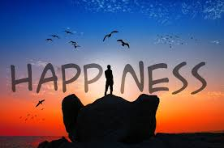
10 – Spiritual
Happiness
Spirituality is to do with our relationship with the bigger picture and acting for the whole rather than the individual.
According to research people with some form of spiritual practice have higher levels of happiness.

Slide 33
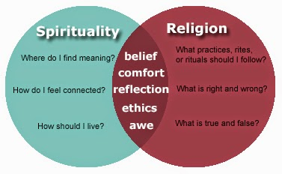

Slide 34
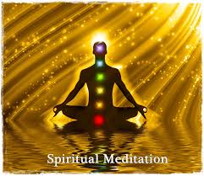
Eight weeks of mindfulness meditation, for instance, can lead to greater activity in the left, pre-frontal cortex, the seat of positive emotions in the brain.

Slide 35
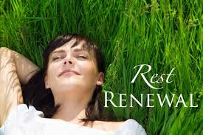
11 – Rest & Renewal
Modern lifestyle may not allow much time for rest and renewal but without it, you risk becoming depleted and depressed.
Renewal involves attending to your needs, restocking your reserves and finding the right balance between activity and rest – too much of either leads to sub-optimal living.
Notes:
depleted : use up the supply or resources

Slide 36
12 – The Fun Factor
Make a “playlist” of things you enjoy and prioritize spending time doing them.
Use all your senses to enjoy the pleasures of the here and now.
Having fun isn’t just about boosting happiness after-hours, it can also stimulate creativity and productivity in the workplace.

Slide 37
